Slide 1
CPE 656
Software Engineering Studio I
Train Location Project
University of Alabama in Huntsville
November 25, 2015
Stephen Jalbert
Rashad Madyun
Corey Sanders

Slide 2
WORK PRODUCTS
Status
SDD: Completed Draft
Geometry Collection: Collected Measurements with Both Laser Range Finders
SDP & CMP: Reorganized per recommendation

Slide 3
WORK PRODUCTS
Status (cd.)
SRS: Added new figures. Improved text descriptions.
Hardware: Completed Assembly. Made initial tests on track.
UI: Created View Prototypes

Slide 4
WORK PRODUCTS
Agenda (11/25 – 11/30)
Documents,
  Update Documents From Feedback
Geometry Collection
  Evaluate accuracy of laser range finder measurements from table mounts

Slide 5
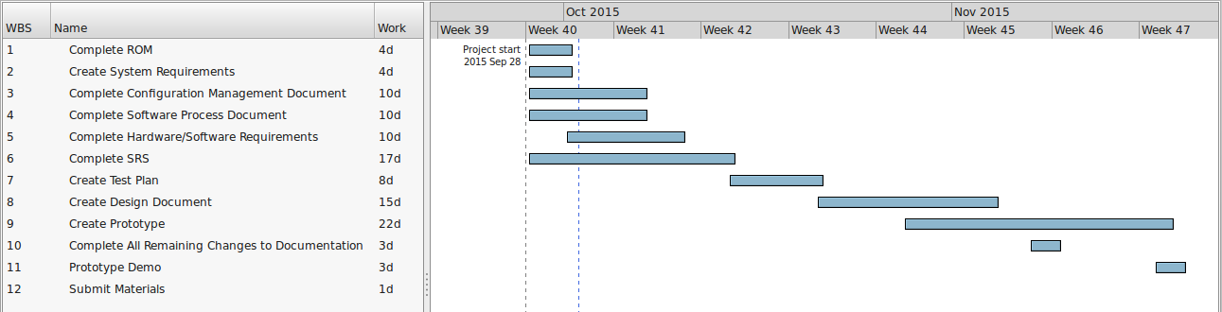
Schedule

Slide 6
Schedule (pt 2)
Work Product | Date Drafted Expected | Estimate Date for Completion
ROM | 10/1 | 10/1
SRS | 10/14 | 11/30 | Need to make less abstract
CM | 10/7 | 10/7
SDP | 10/7 | 10/7
STP | 10/21 | 11/30 | Need to clarify video testing
SDD | 11/4 | 11/30 | Need feedback
Prototype | 11/18 | 12/7 | Working on Hardware, Working on UI Mockup, Working on Geometry Points

